Slide 1
Travel App & Code Playground App
Submitted by :
Name : Bandi Suresh
LMS Id:- MGSA_526

Slide 2
Contents
Introduction
Module-1
Module-2
Module-3

Slide 3
Introduction
Salesforce,provides CRM software and applications focused on sales, customer service, marketing automation, analytics, and application development.
Salesforce's main technologies are tools for customer management. Other products enable customers to create apps, integrate data from other systems, visualize data, and offer training courses.

Slide 4
Module -1
In This module we will create Travel Custom App, Objects, Fields & Relationships, and customize the App using Declarative tools.
By end of this module we have working prototype of Travel Approval Application.

Slide 5
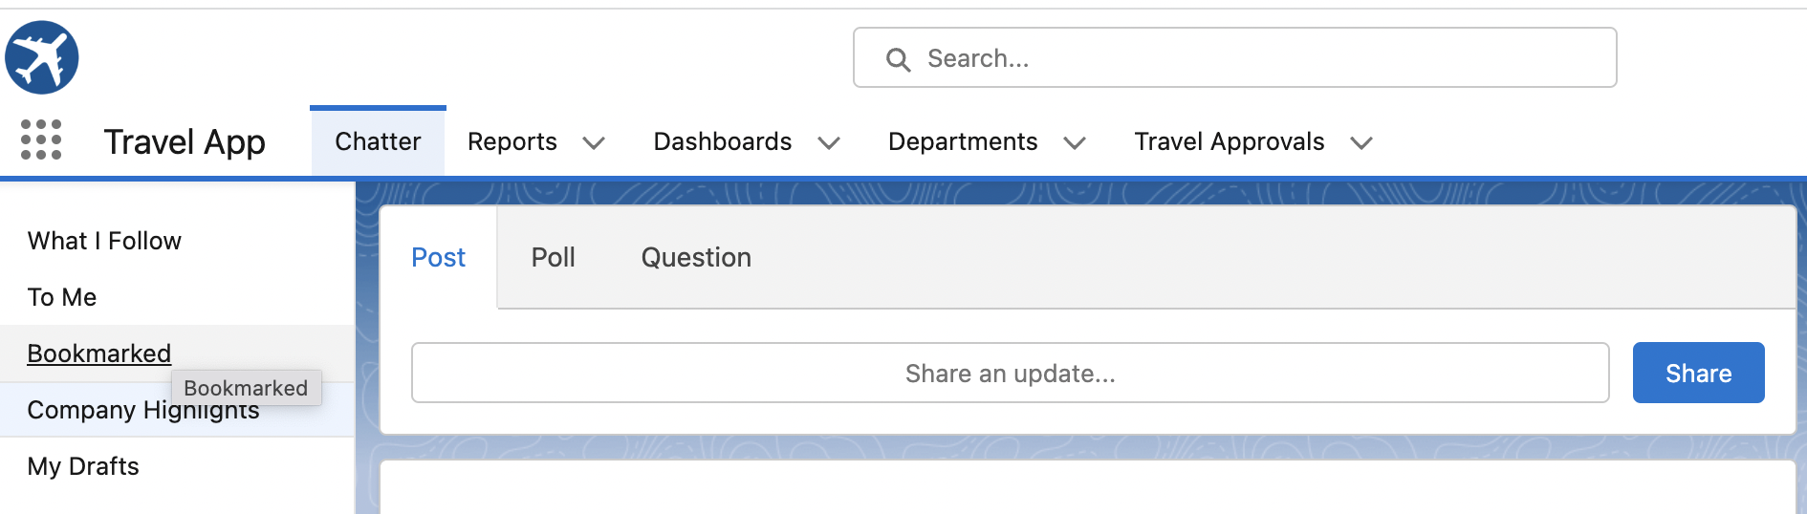
Created Custom lightning App “ Travel App”.

Slide 6
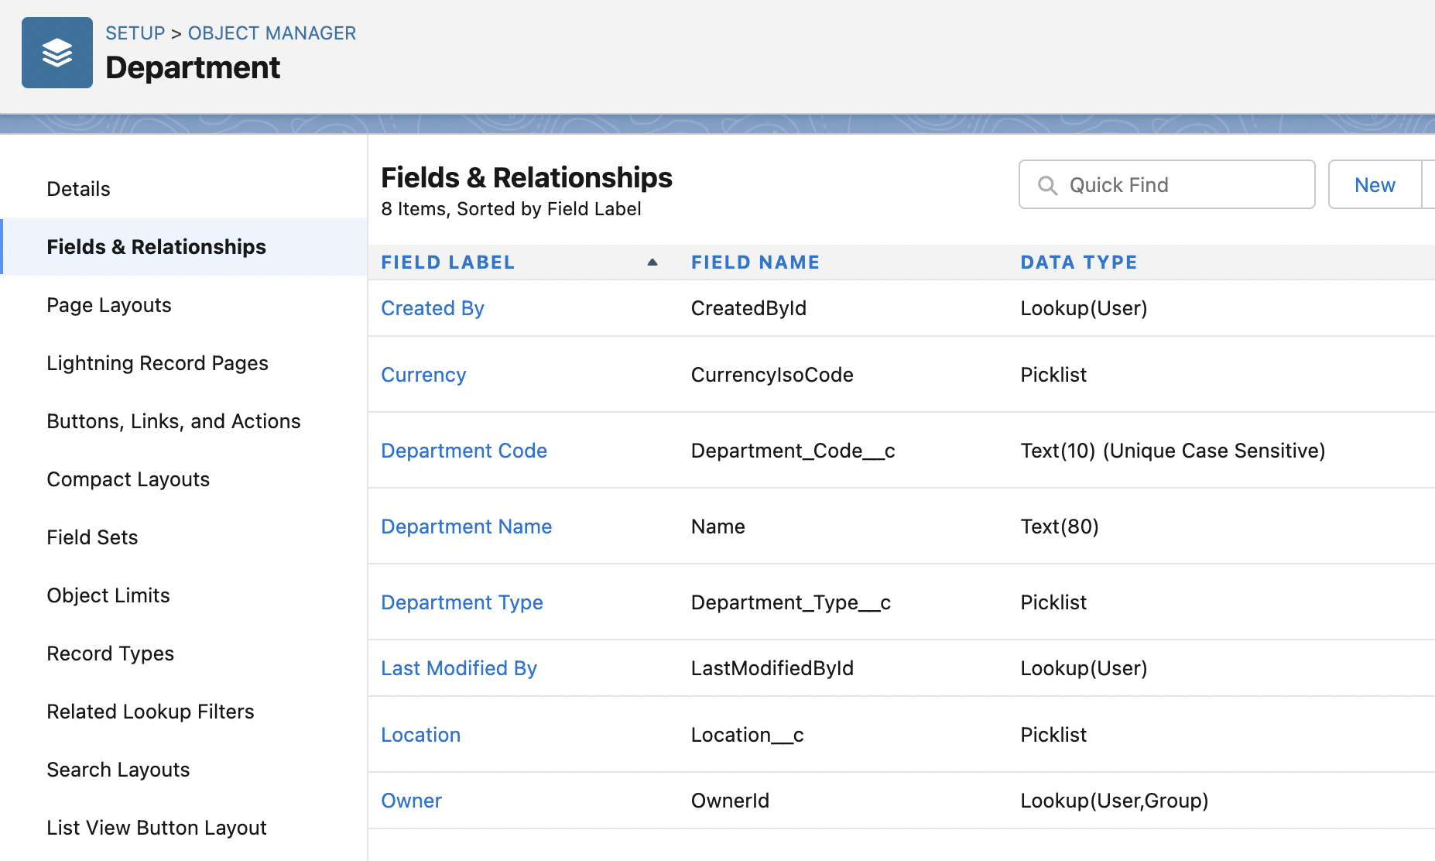
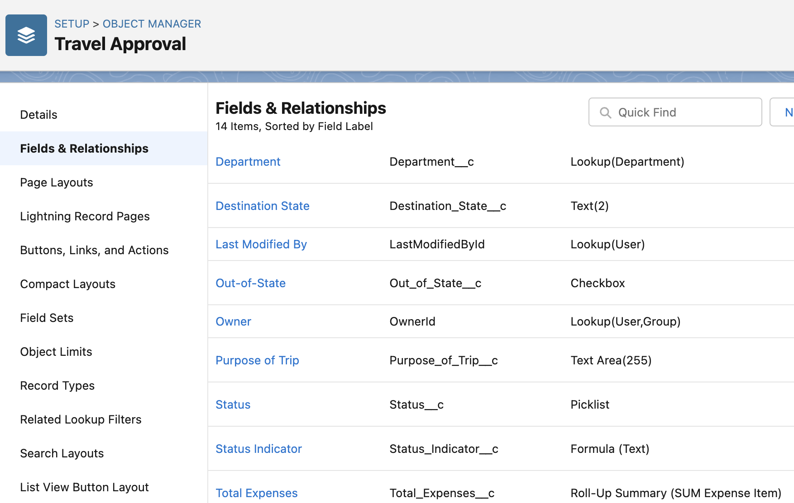
Created Department and Travel Approval custom objects and respective fields.

Slide 7
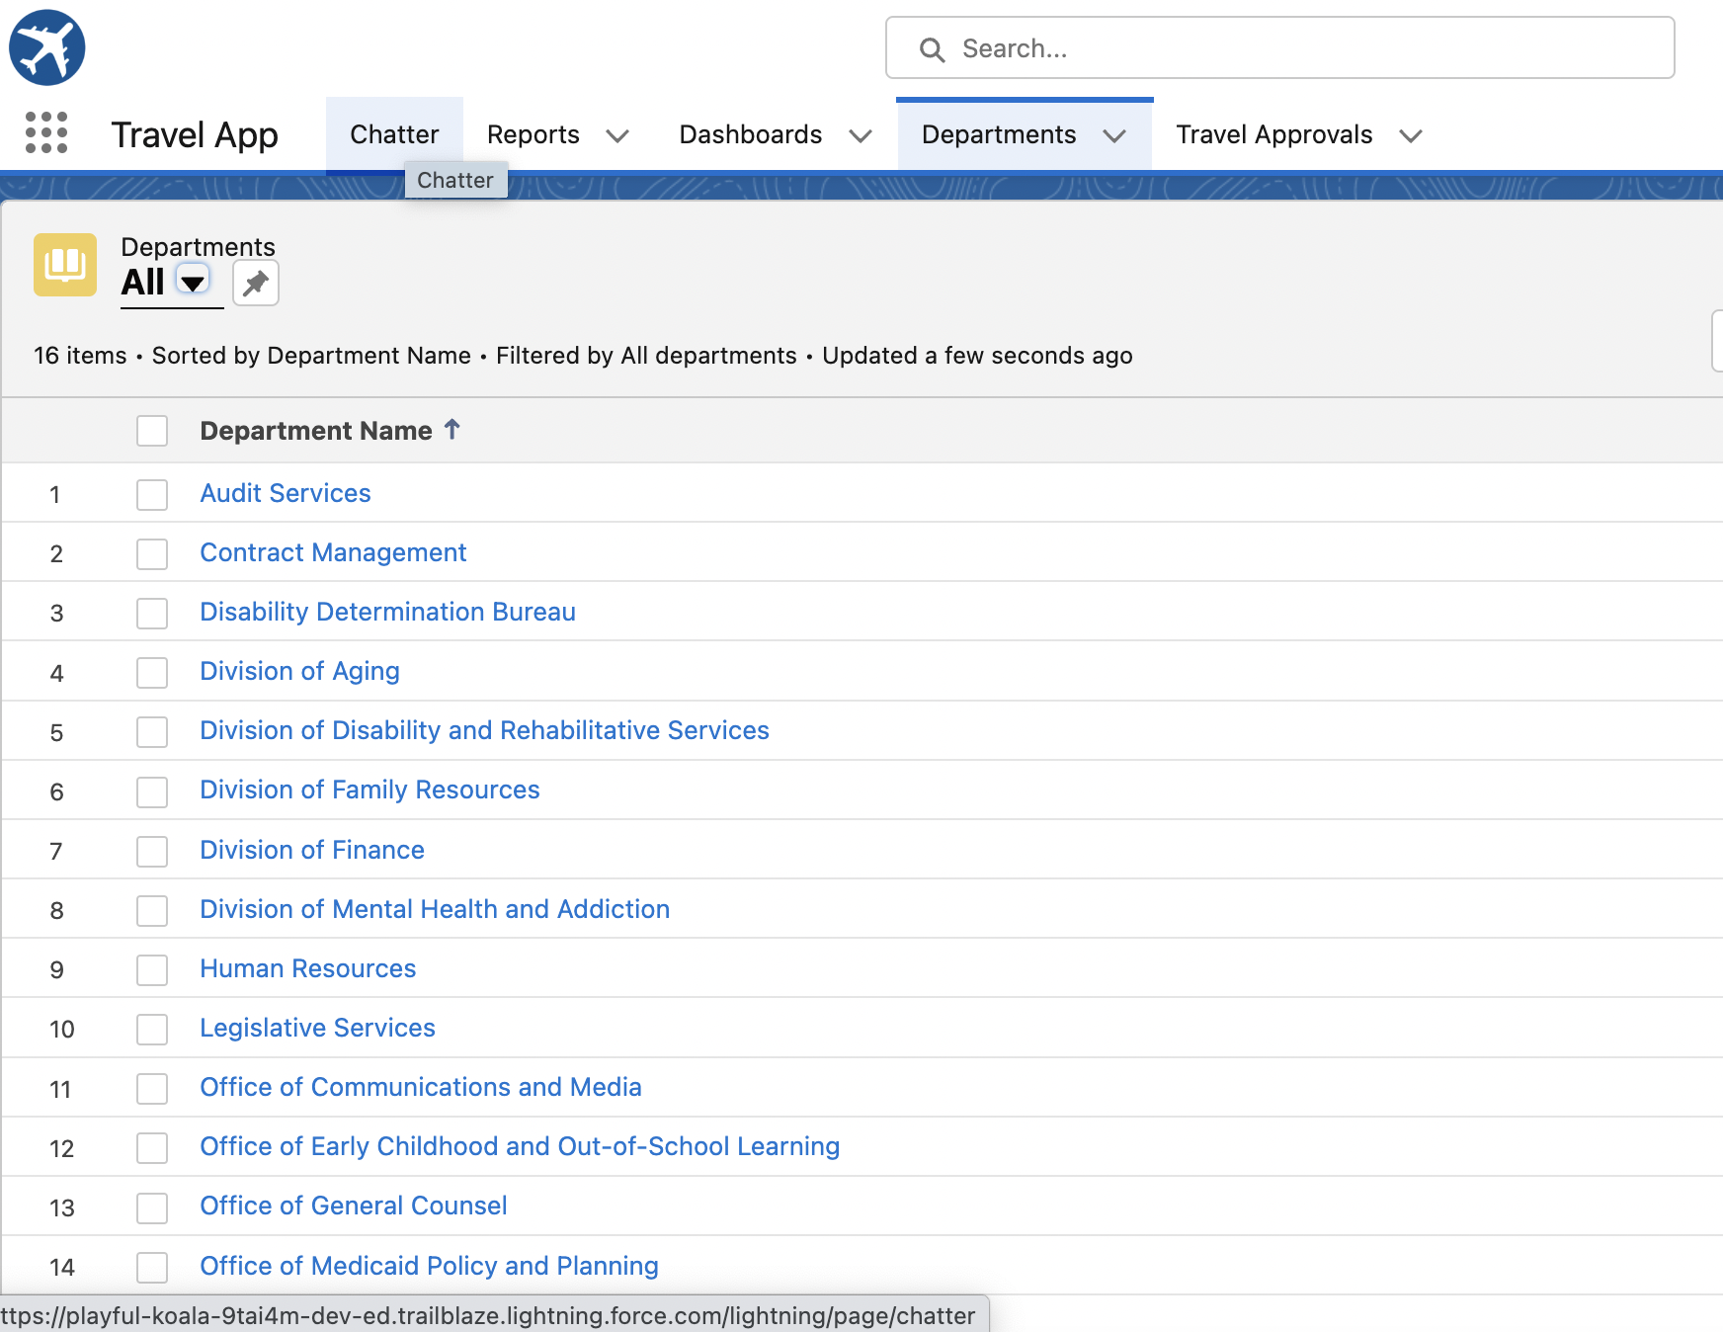
Imported the data from departments.csv file

Slide 8
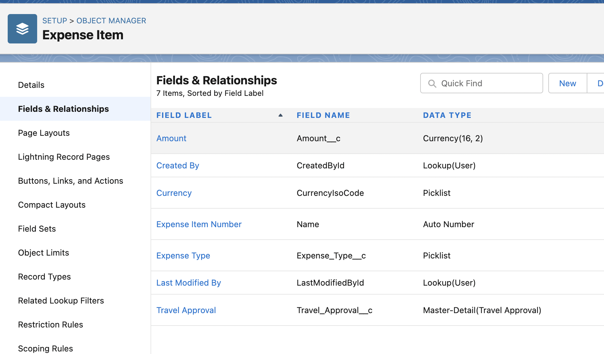
Created Expense Item Custom Object and respective fields

Slide 9
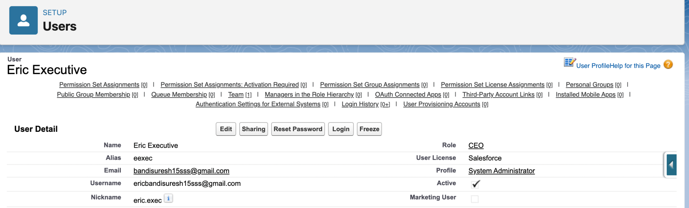
Created User Eric Executive and added as manager for me.

Slide 10
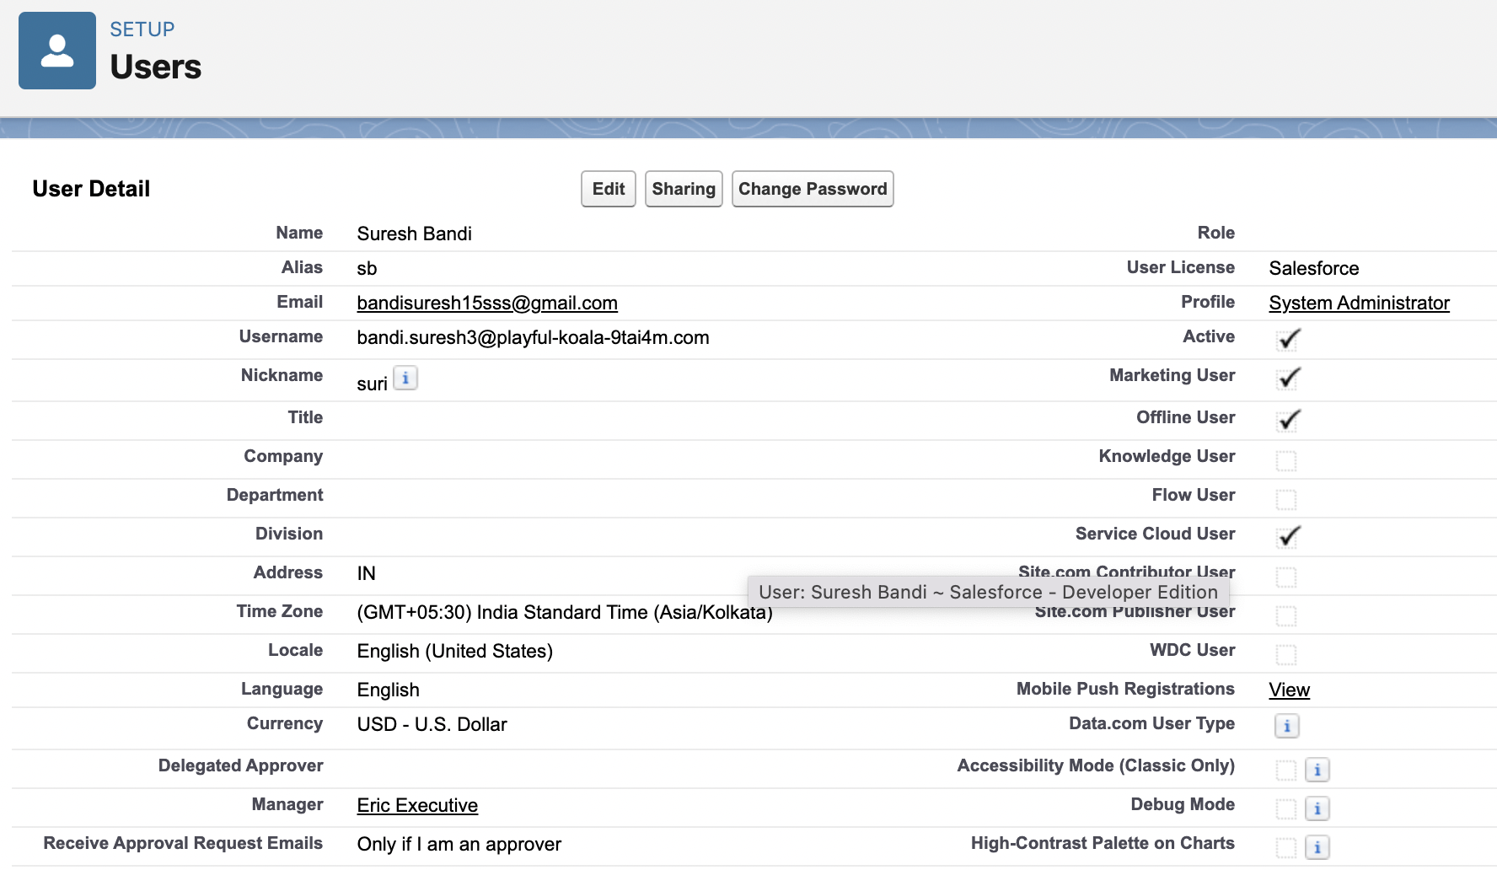

Slide 11
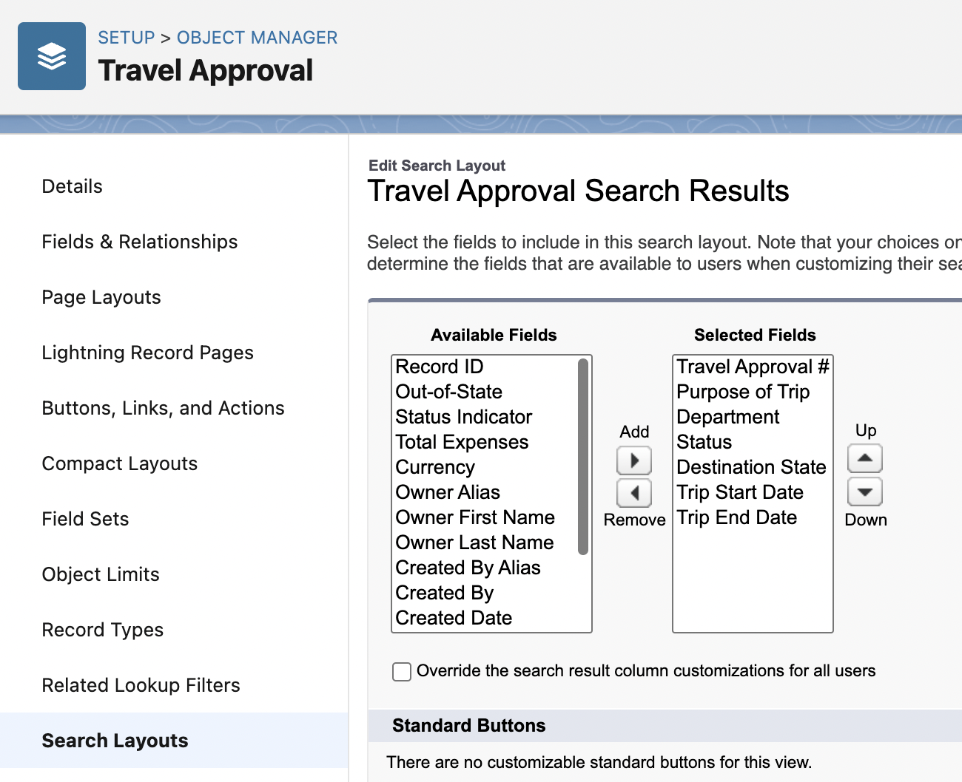
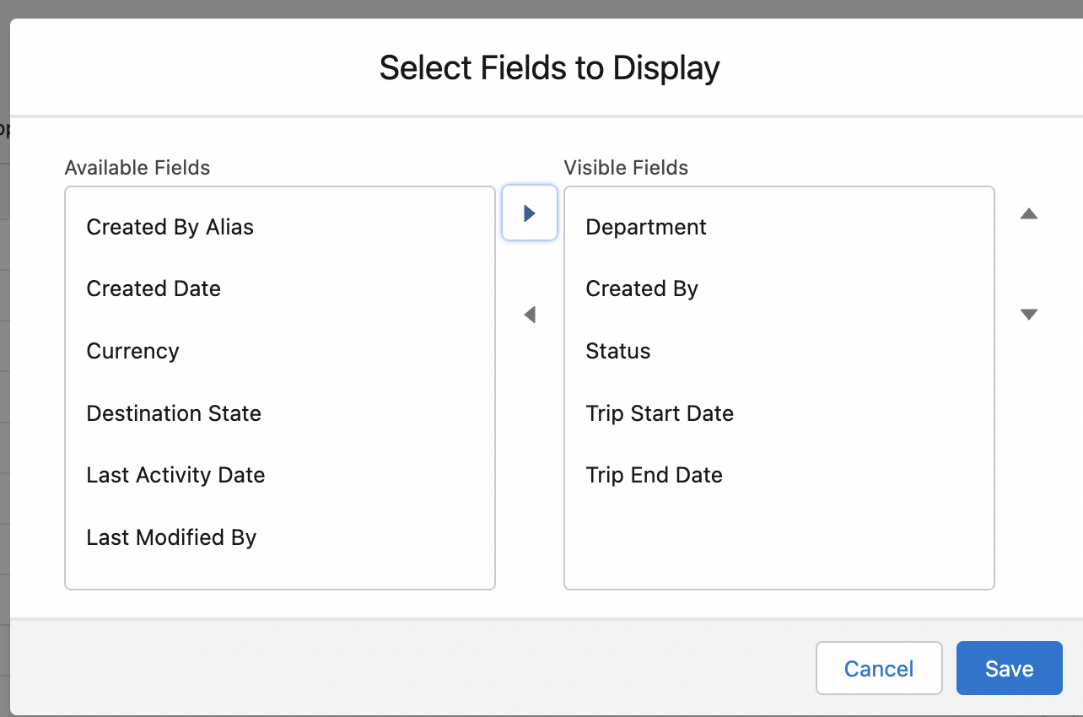
Customized the travel approval default search layout and list view

Slide 12
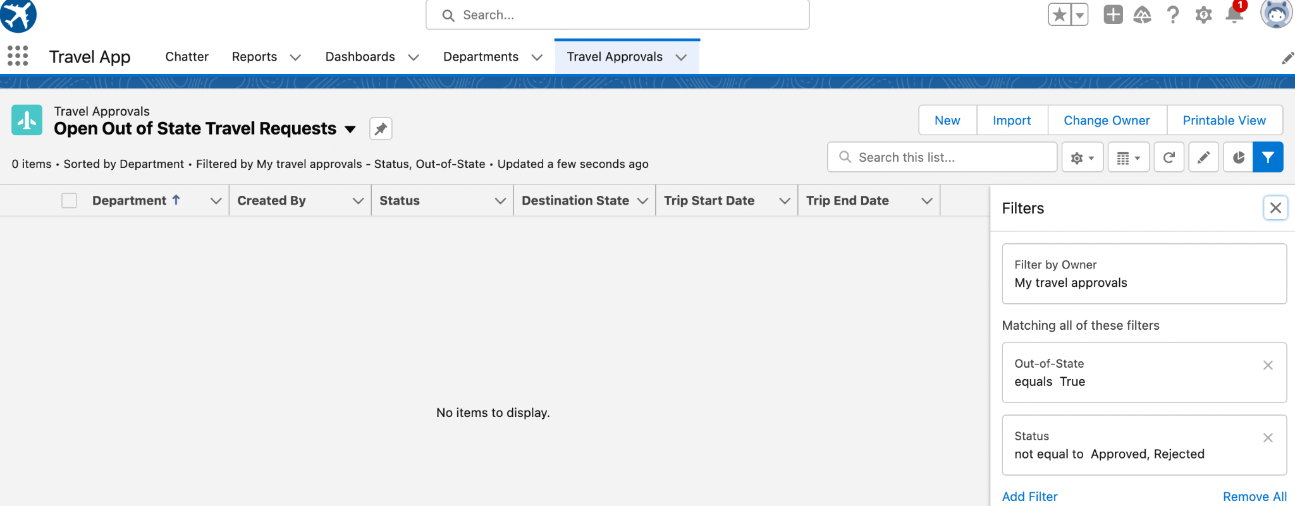
Created custom list view i.e open out of state travel requests

Slide 13
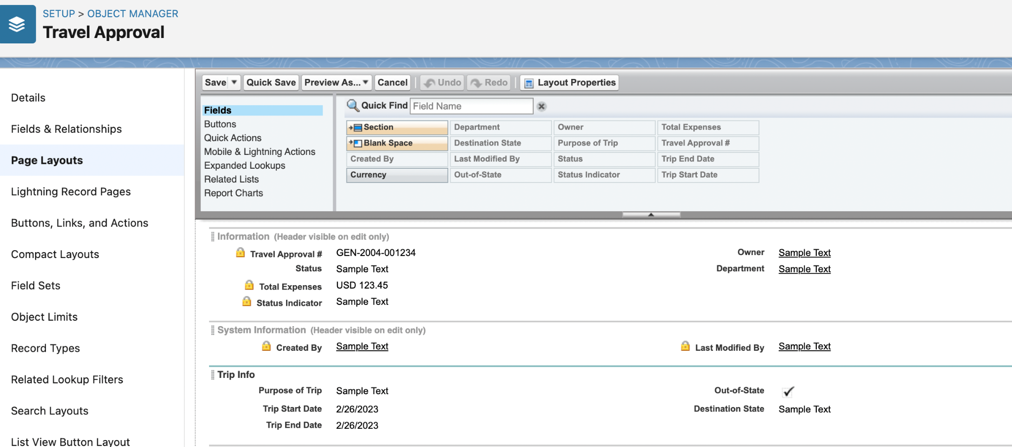
Customized the travel approval page layout

Slide 14
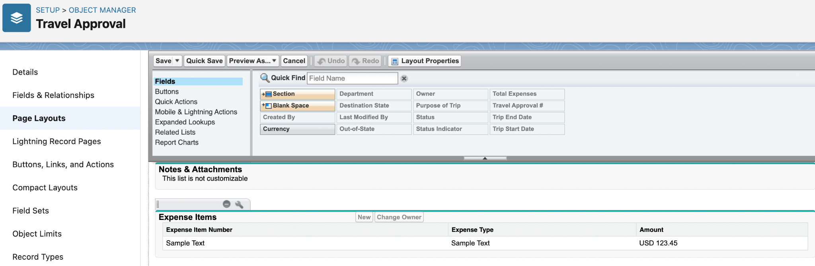
Customized the Expense item related list under travel approval page layout

Slide 15
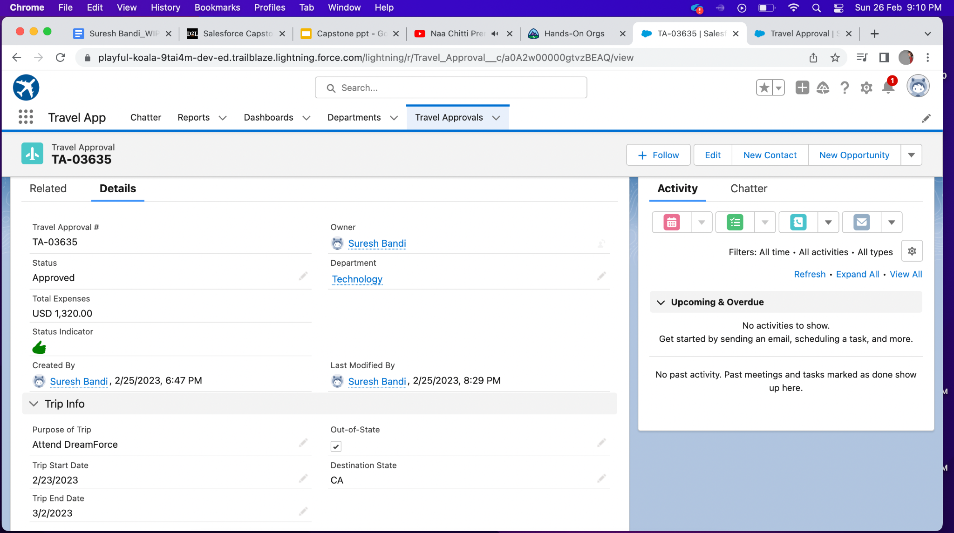
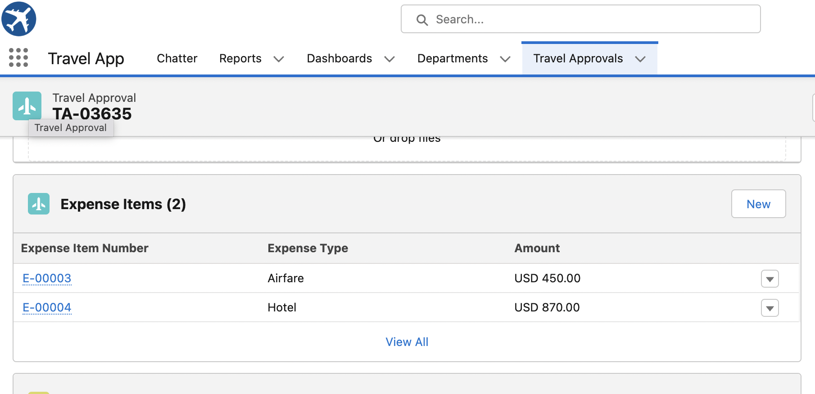
Created Travel Approval and Expense Item records

Slide 16
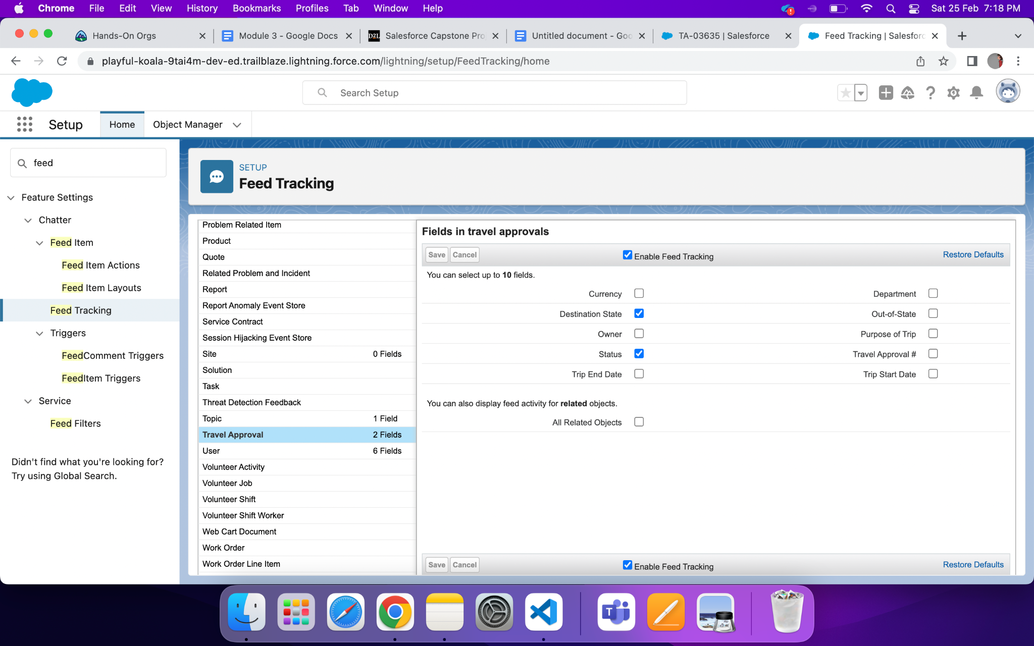
Enabled Chatter on travel approval object

Slide 17
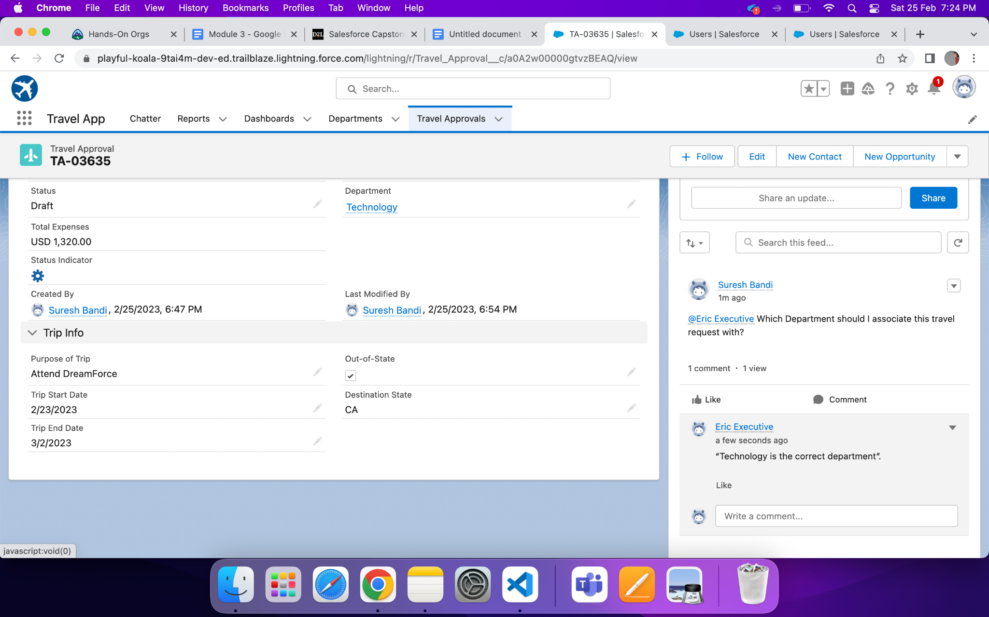
Test Collaboration

Slide 18
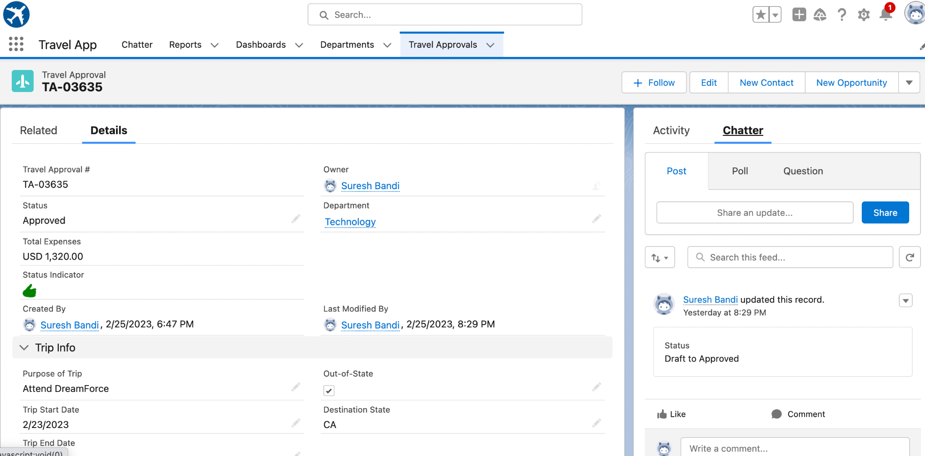
Overview of Travel Approval Record

Slide 19
Module - 2
In this module we add business logic and analytics to the travel approval app to improve user experience.
validation rules to enforce data integrity.
Automated the business process with flows.

Slide 20
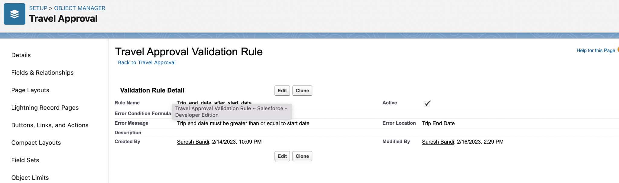
Validation rule to ensure Trip end date > Trip Start date

Slide 21
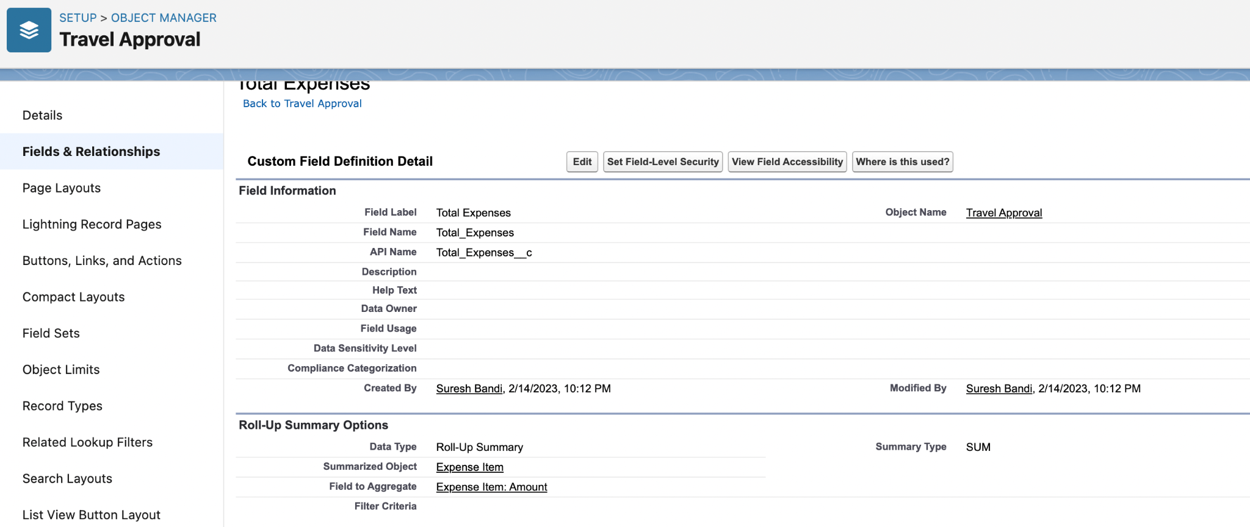
Roll-Up summary field on Travel approval object

Slide 22
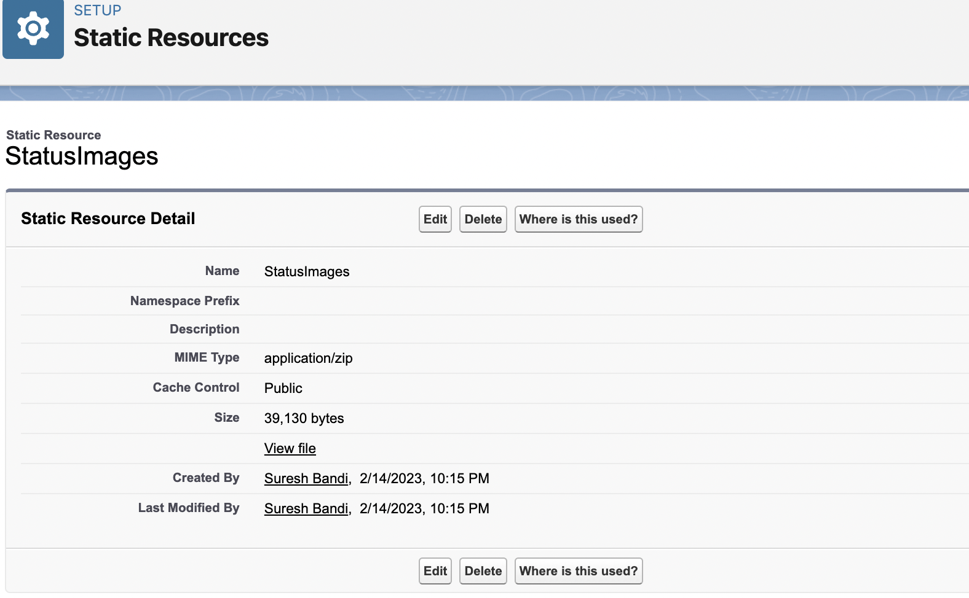
Created Static Resources.

Slide 23
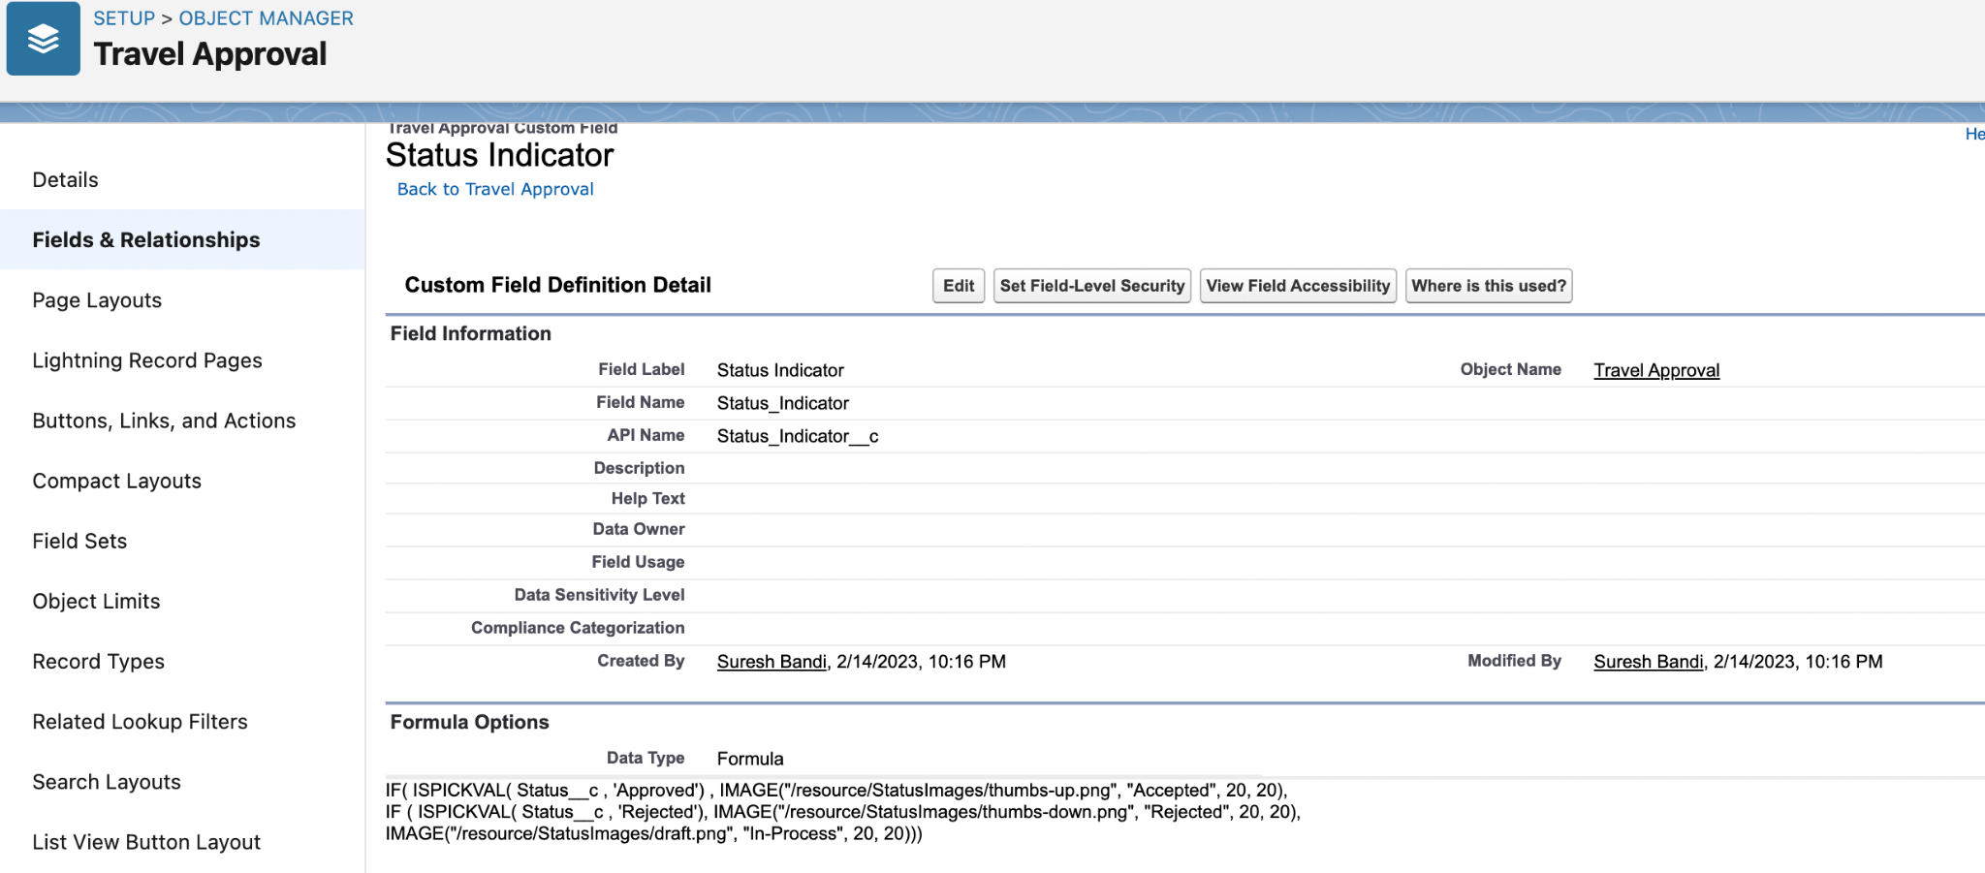
Formula field to show Image based on status field on travel approval object

Slide 24
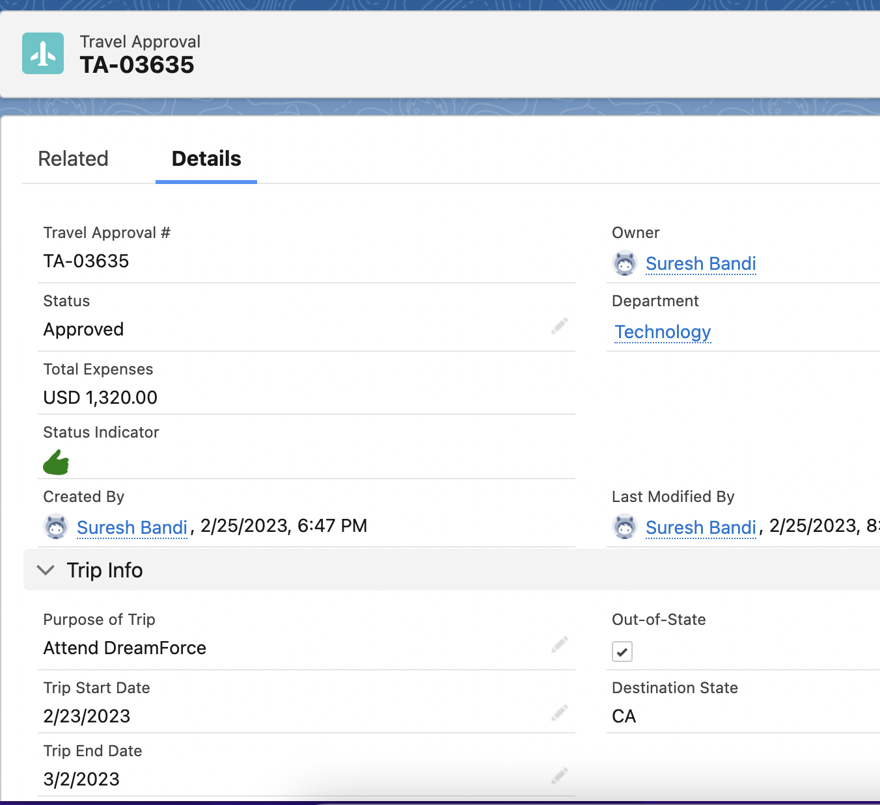
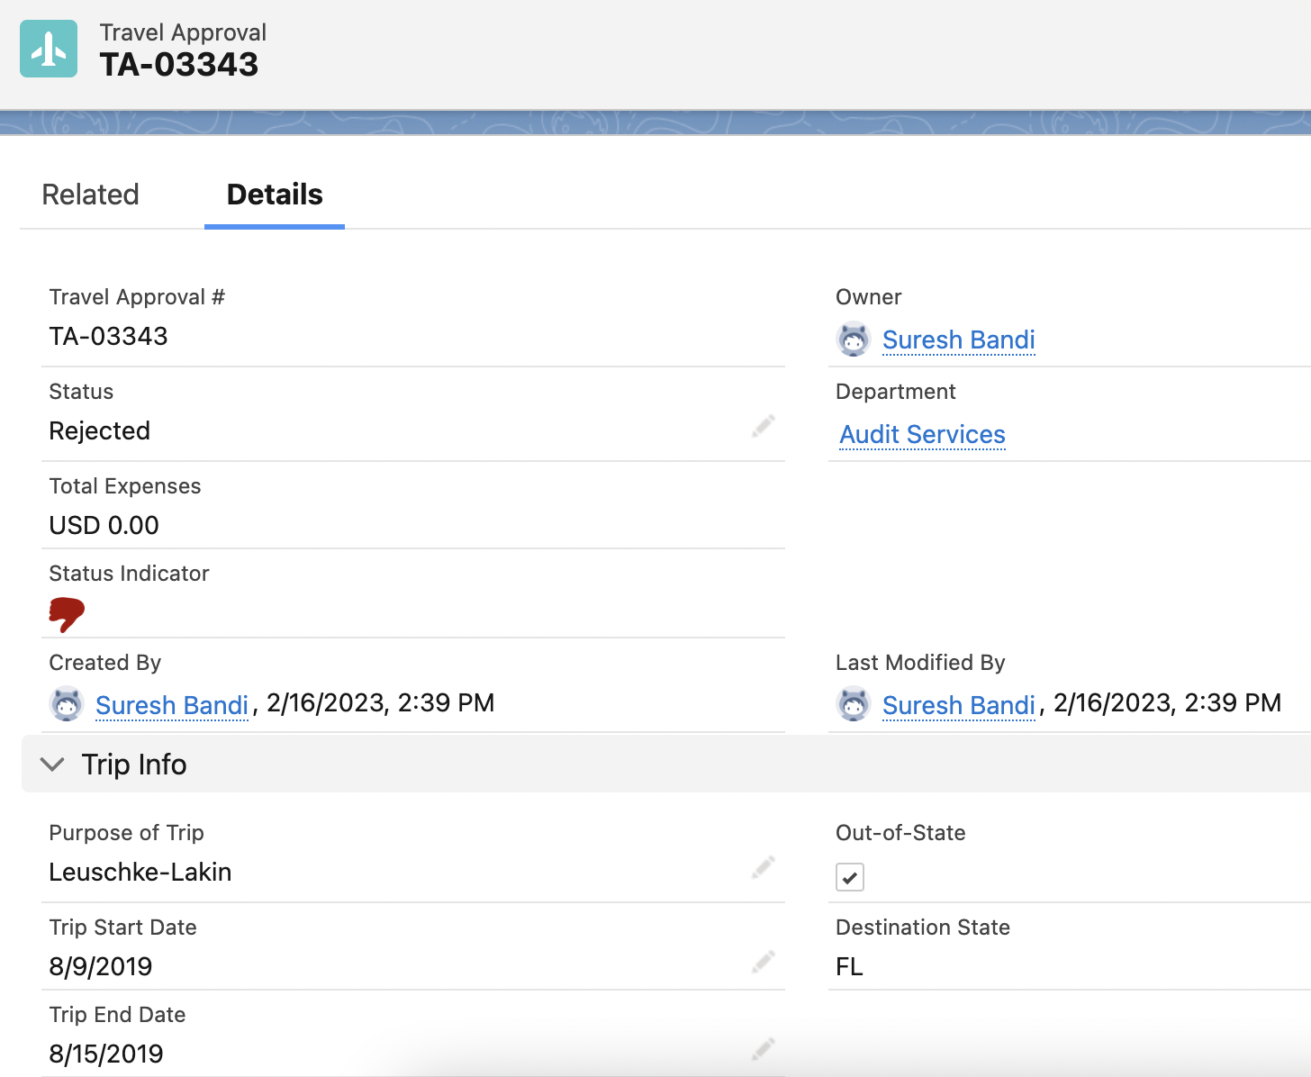

Slide 25
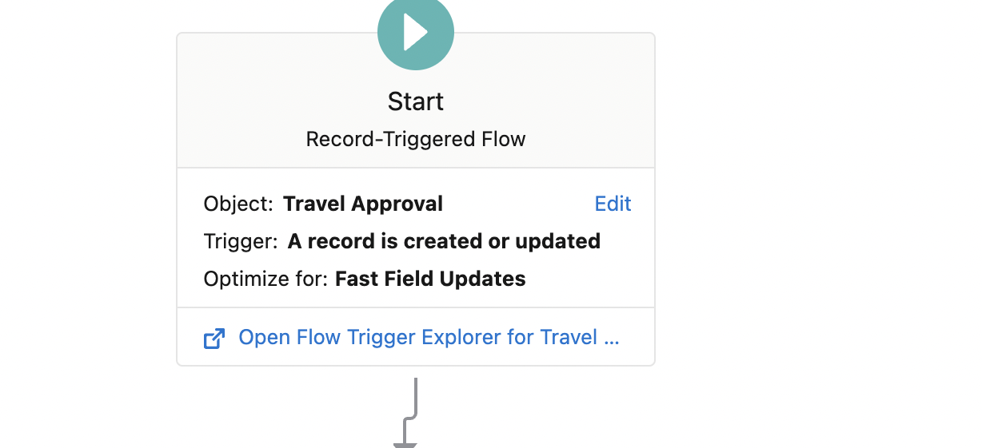
Created Out of state Travel Flag record triggered flow.

Slide 26
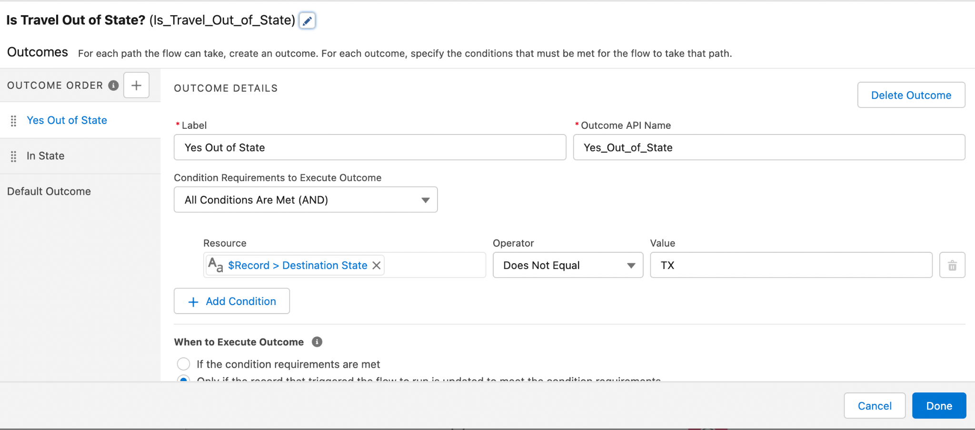
Add Decision element to check the state is in or out

Slide 27
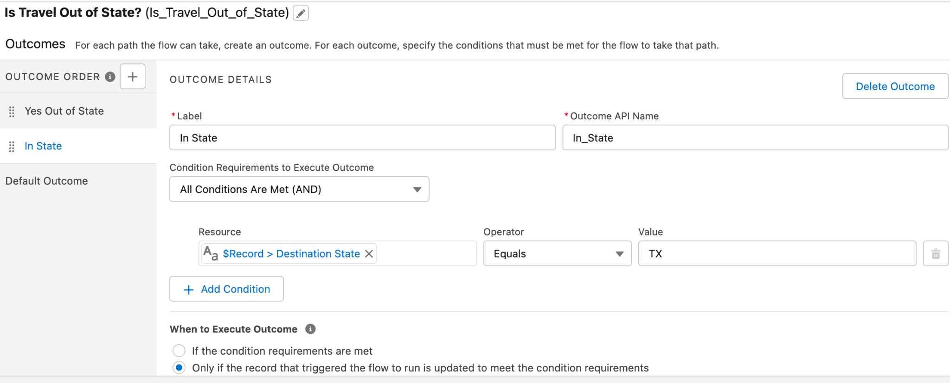

Slide 28
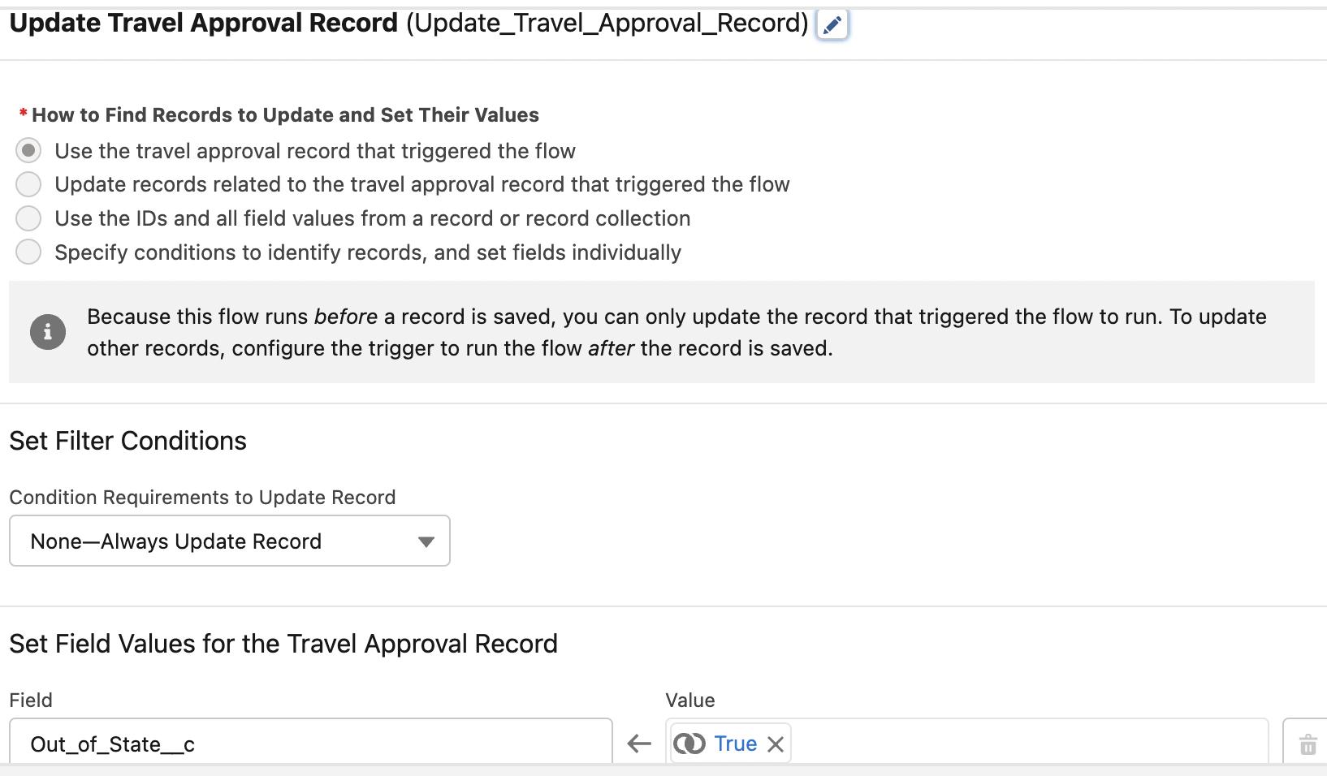
Updated the Travel Approval record when Travel is out of State.

Slide 29
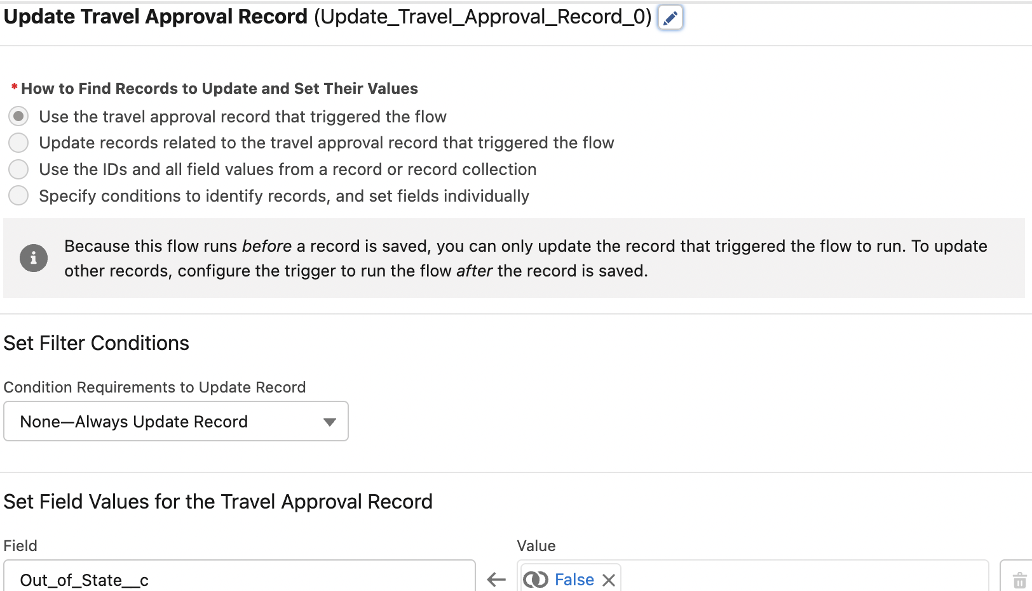
Updated the Travel Approval record when Travel is In State.

Slide 30
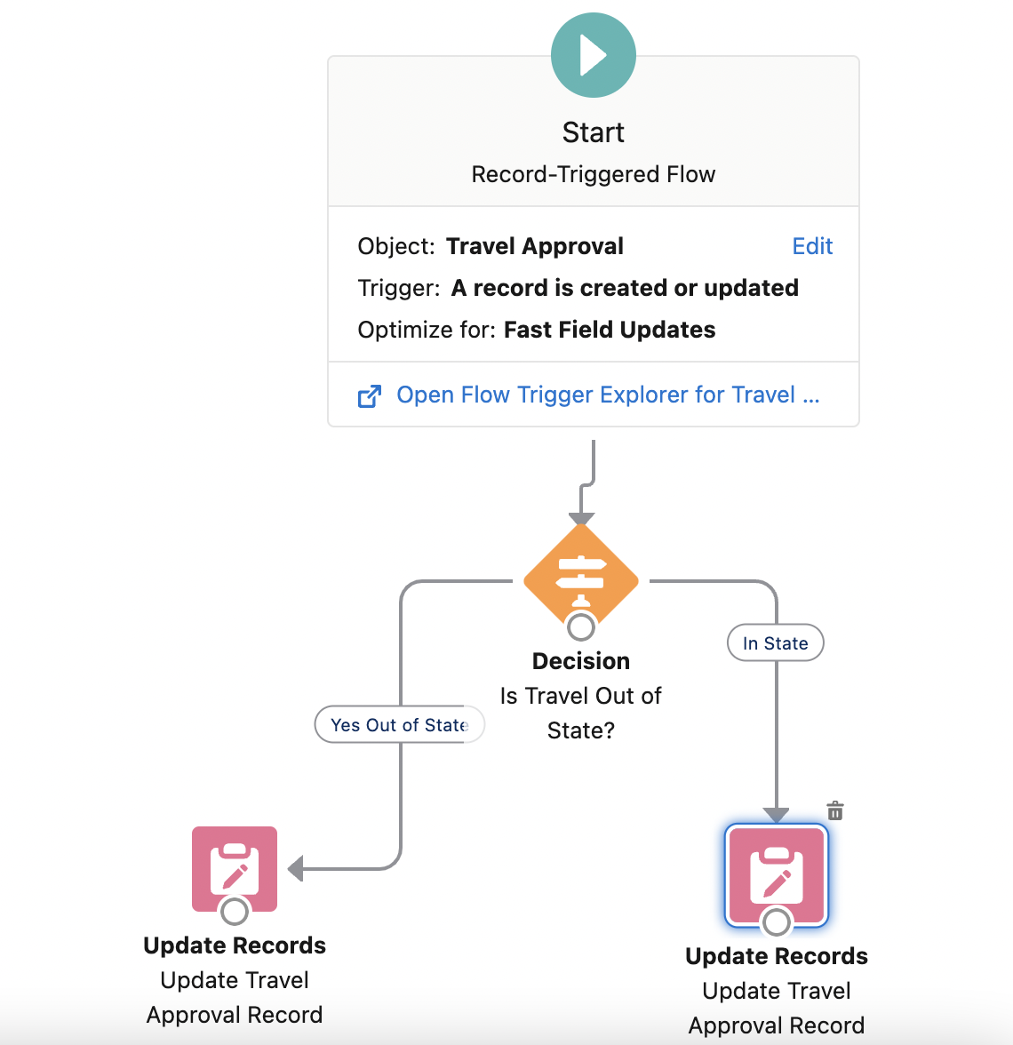
Flow Screen

Slide 31
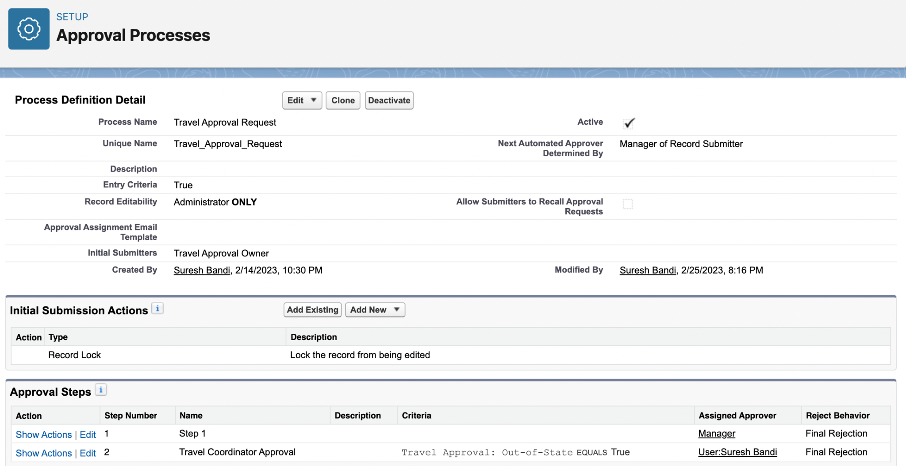
Created an Approval process for Travel Approval request.

Slide 32
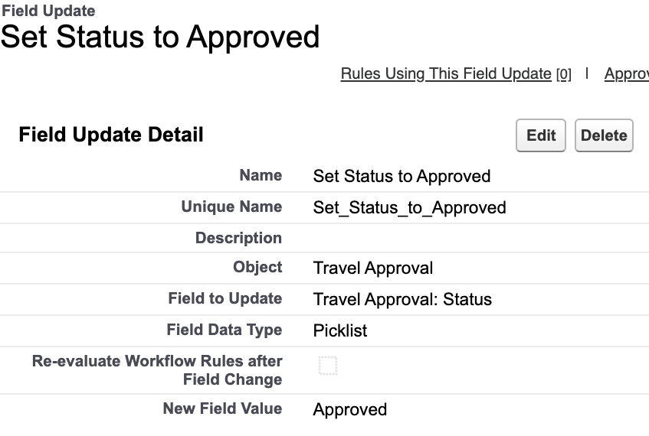
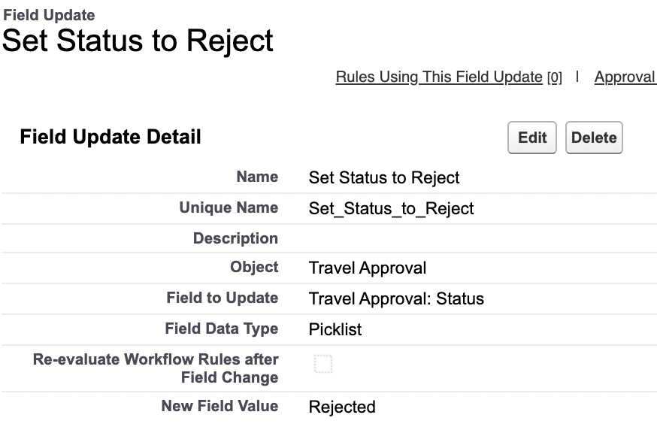
Created Final Approval and Rejection Actions.

Slide 33
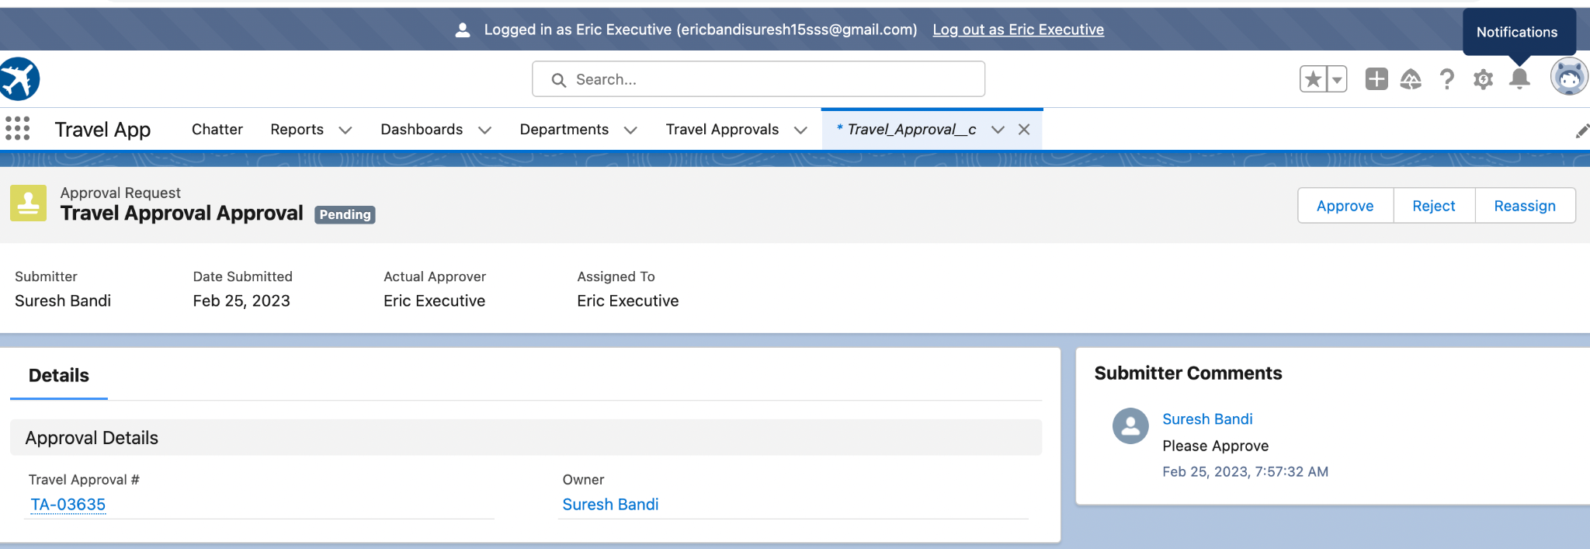
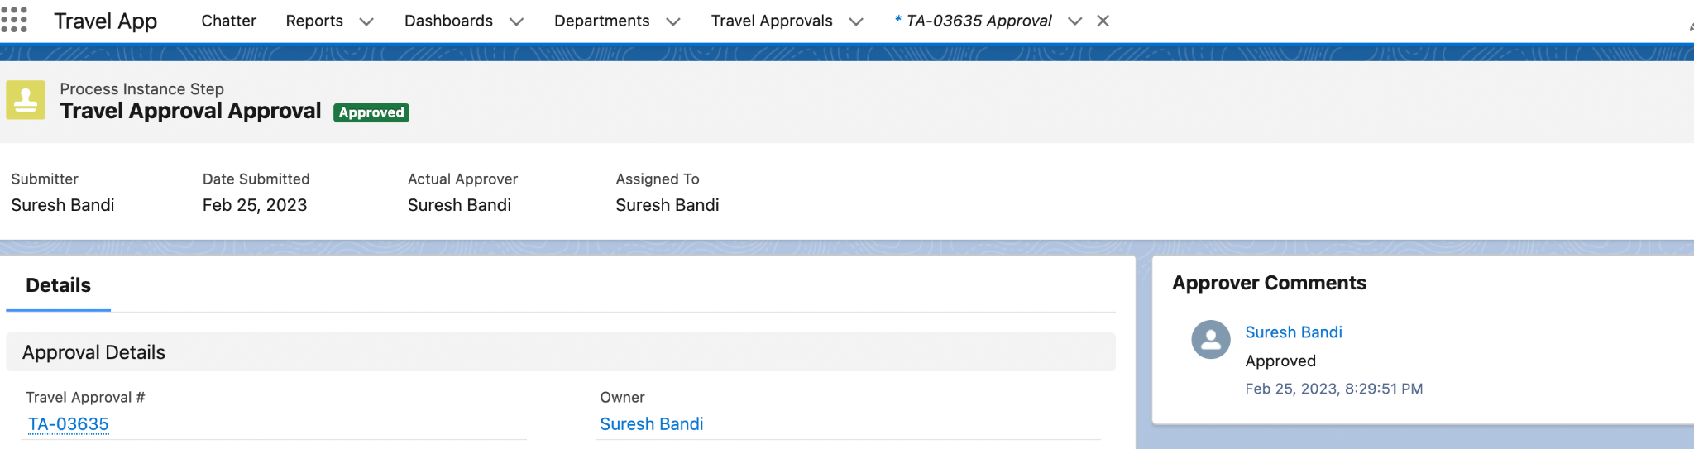
Tested the Approval process

Slide 34
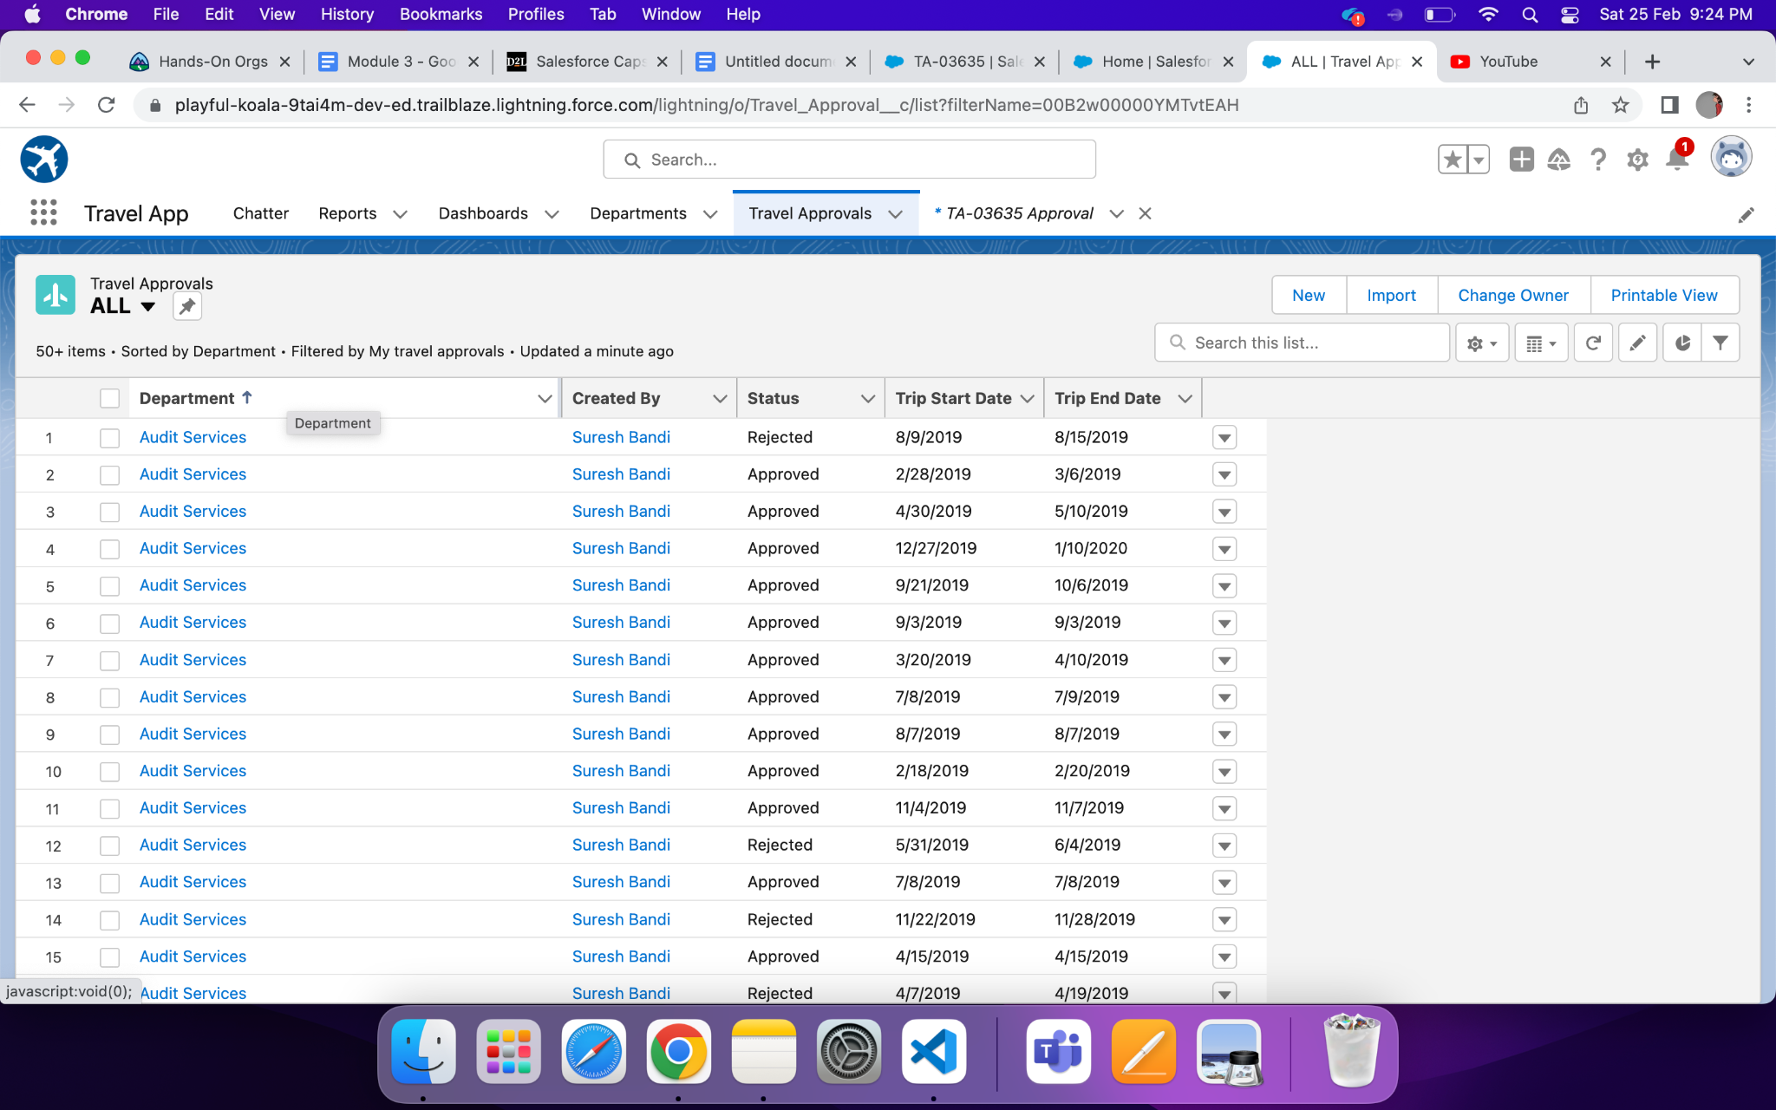
Imported Travel Approval Records Using Data Import Wizard.

Slide 35
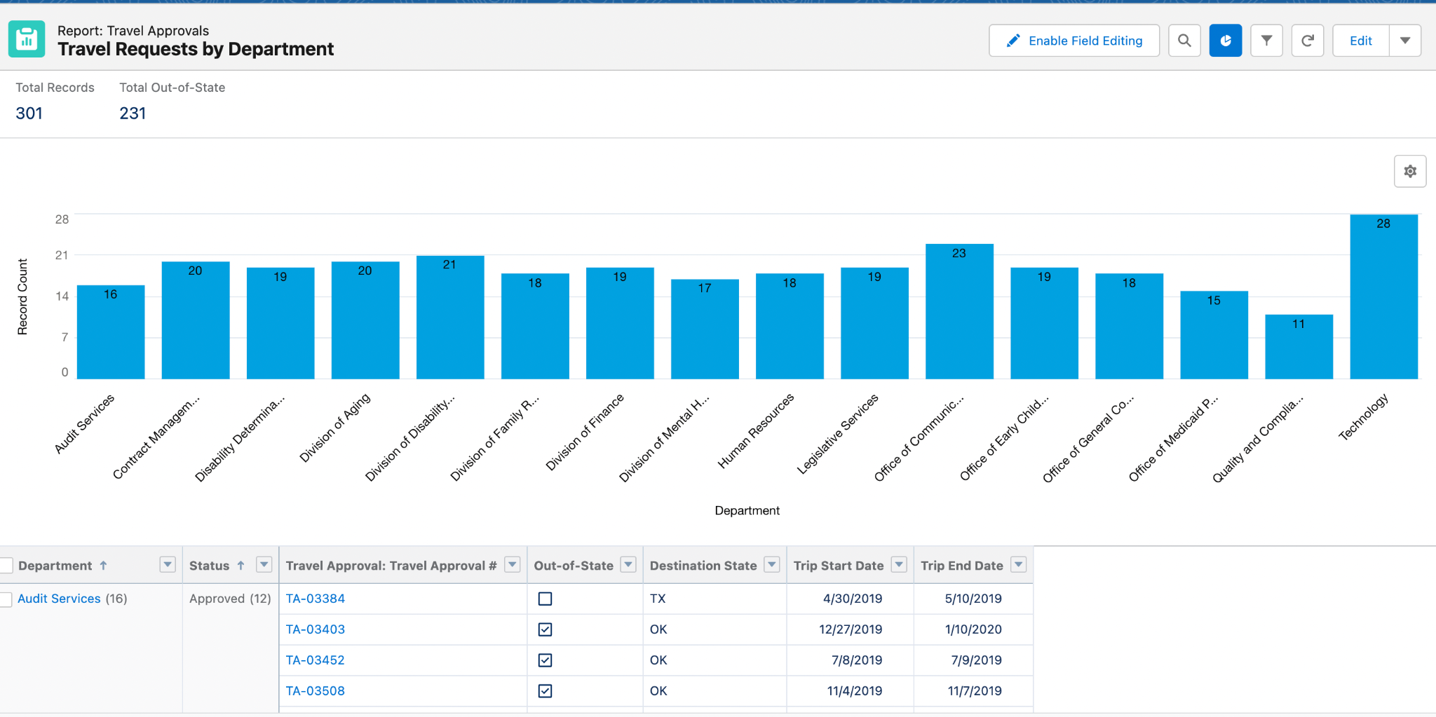
Created Travel Requests by Department Report.

Slide 36
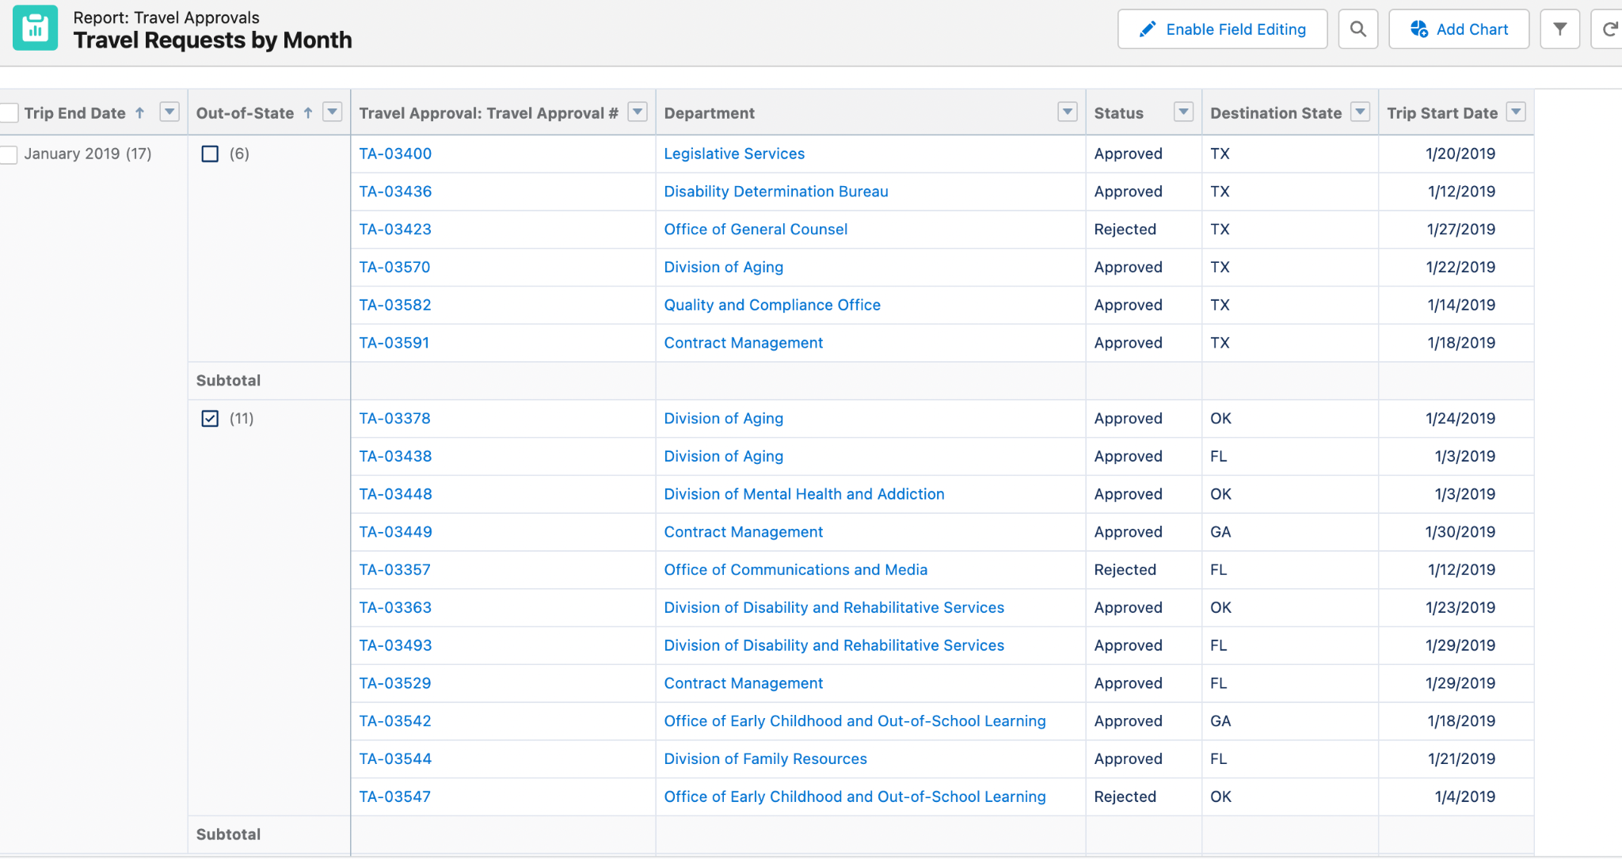
Created Travel Requests by Month Report.

Slide 37
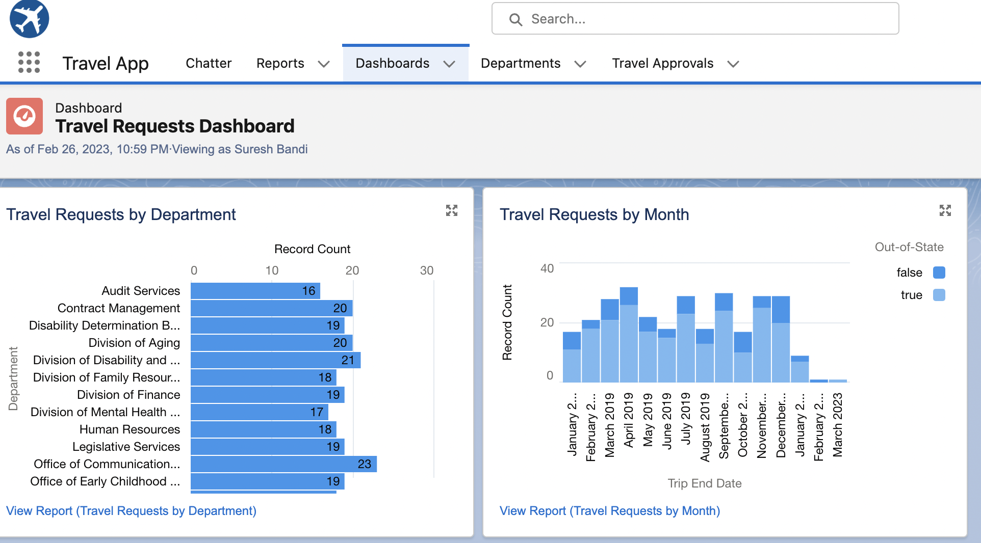
Created Travel Approvals Dashboard.

Slide 38
Module - 3
This module focuses on the coding approach to extend the functional capabilities of the Code Playground App.
Apex enables to build complex business processes, customized user interfaces and integration with third party systems.

Slide 39
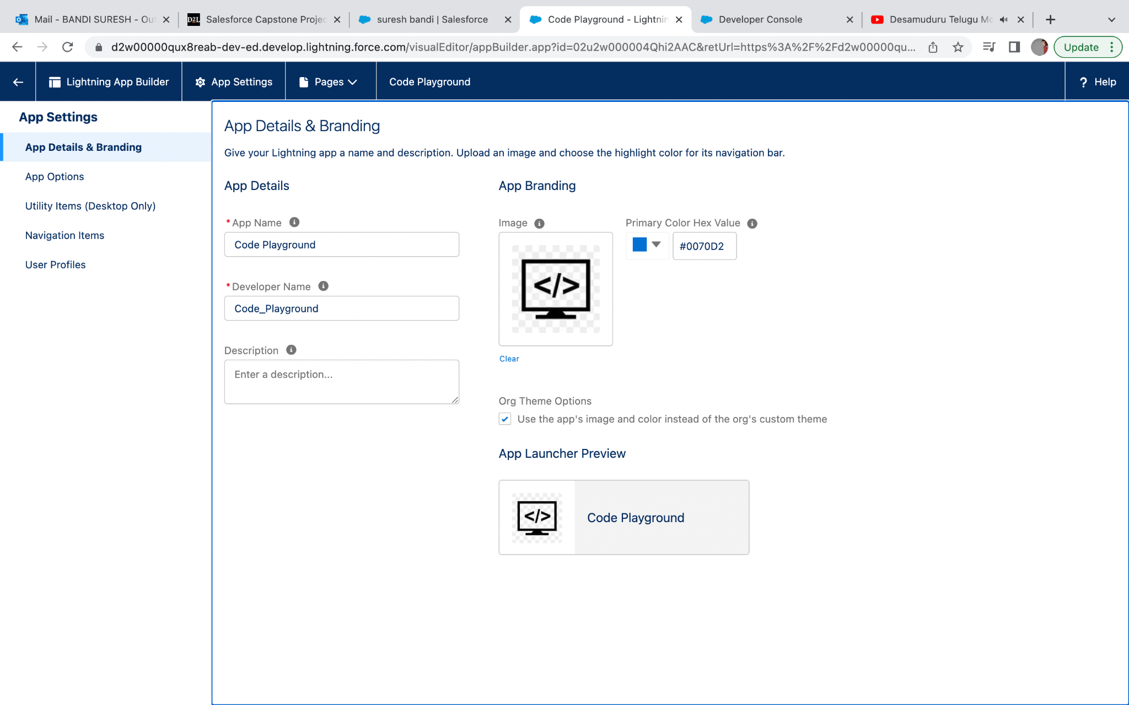
Created custom lightning app Code Playground

Slide 40
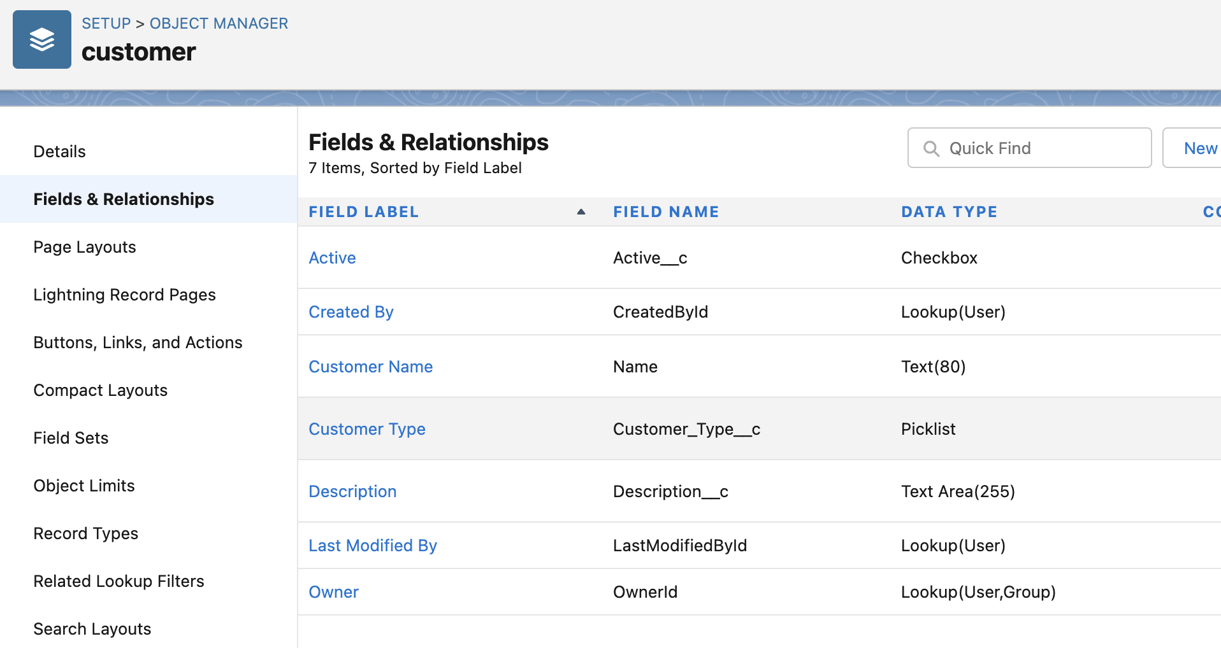
Created Customer Custom Object and Respective custom fields.

Slide 41
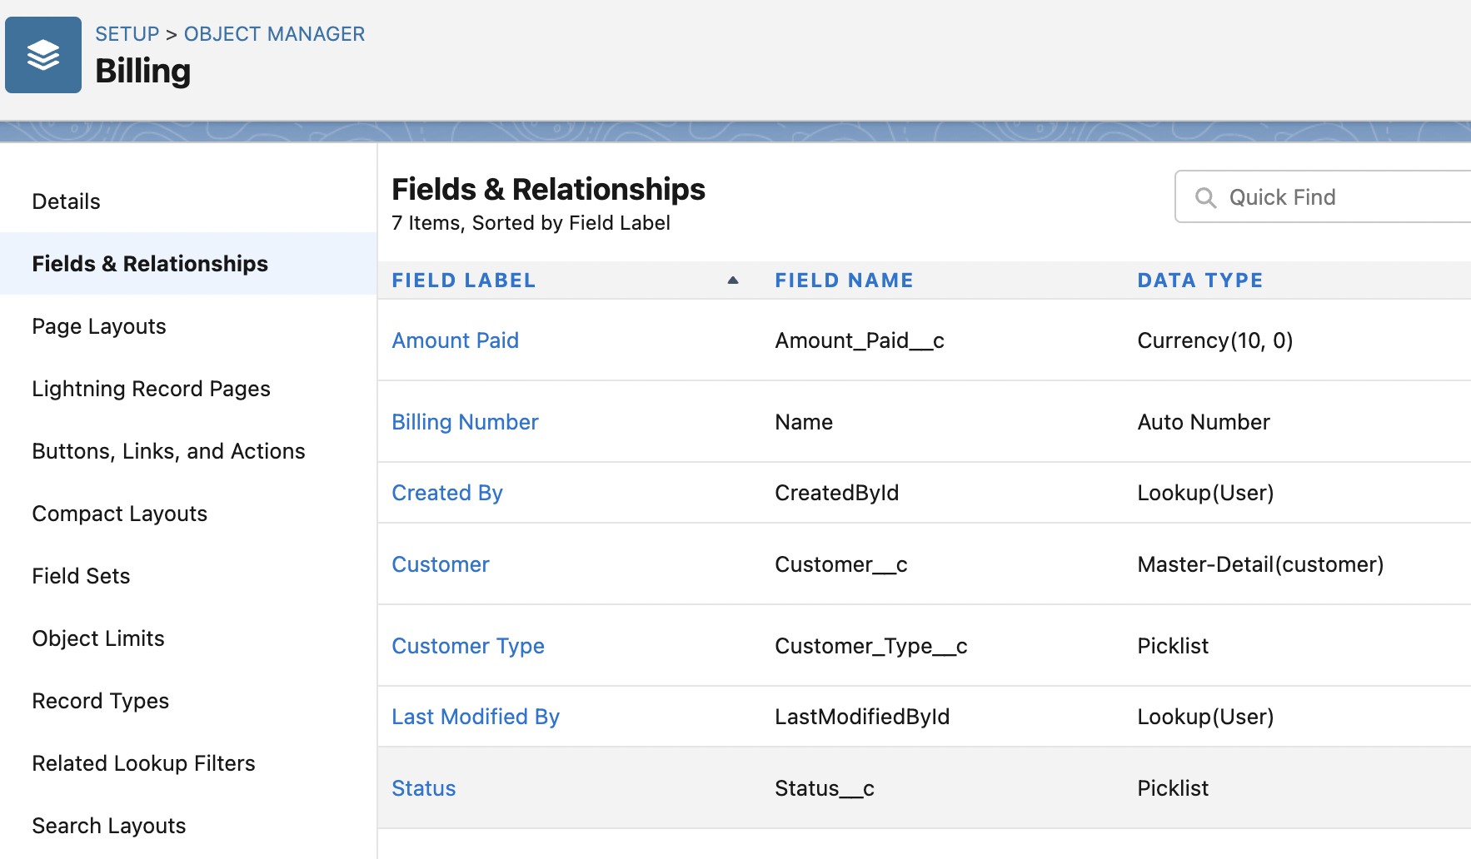
Created Billing Custom Object and respective custom fields.

Slide 42
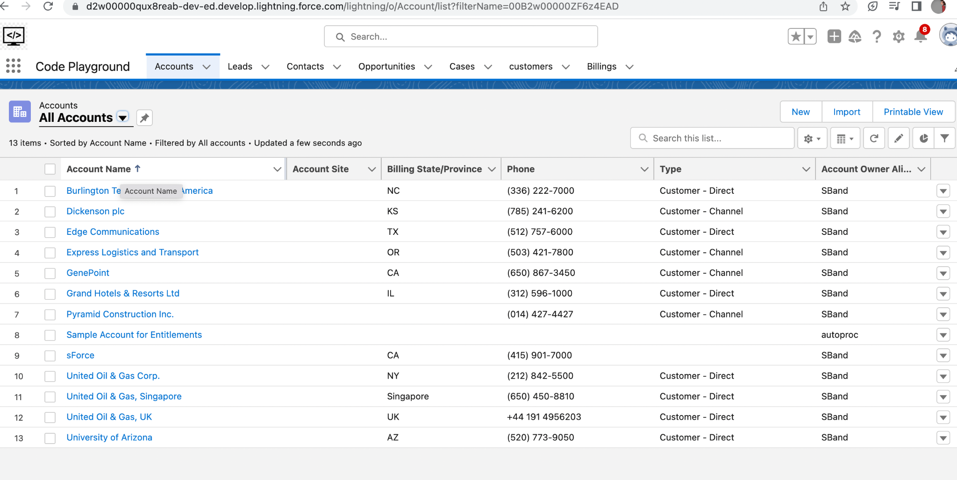
Code Playground App

Slide 43
Thank You

